Slide 1
MATH221 Mathematics for Computer Science
Unit 10
Graphs

Slide 2
Learning Objectives
Graph Terminologies
Euler Circuits
Tree and Minimum Spanning Tree: Kruskal’s algorithm and Prim’s Algorithm

Slide 3
1: Definitions and Basic Properties

Slide 4
Graph Theory
Many real-world problems concern certain classes of objects and
the relations between these objects. The objects could be people
connected through friendship, cities connected through travel
routes, or webpages connected through links.
The mathematical abstraction of these situations is the study of
graph theory. It has applications in almost all fields of study.
The idea of a graph is a simple one: it is just a collection of points,
some of which may be joined together by lines. We now give the
formal definition.

Slide 5
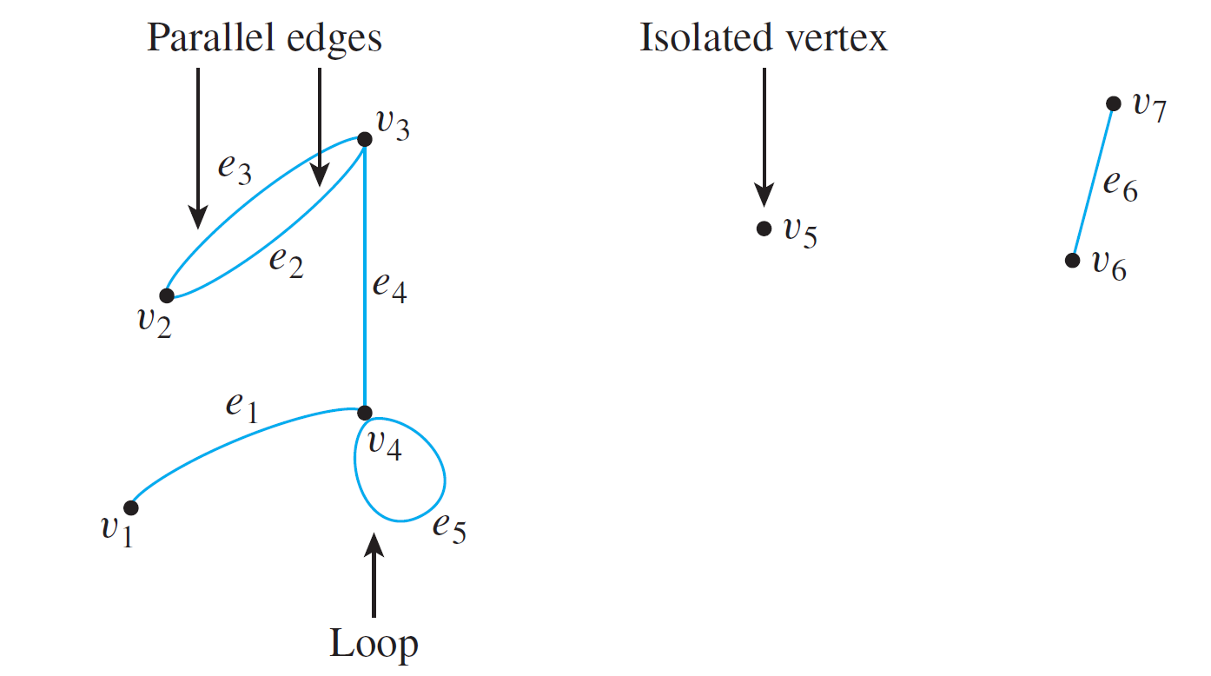
Graphs: Definitions and Basic Properties
A graph G consists of
a set of vertices V(G), and
a set of edges E(G).
Sometimes, we write G = {V, E}.
An edge connects one vertex to another, or a vertex to itself.

Slide 6
Graphs: Definitions and Basic Properties
Definition: Graph
A graph G consists of 2 finite sets: a nonempty set V(G) of vertices and a set E(G) of edges, where each edge is associated with a set consisting of either one or two vertices called its endpoints.
An edge with just one endpoint is called a loop. Two distinct edges with the same endpoints are called parallel.
An edge is said to connect its endpoints; two vertices that are connected by an edge are called adjacent vertices; and a vertex that is an endpoint of a loop is said to be adjacent to itself.
An edge is said to be incident on each of its endpoints, and two edges incident on the same endpoint are called adjacent edges.
We write e = {v, w} for an edge e incident on vertices v and w.

Slide 7
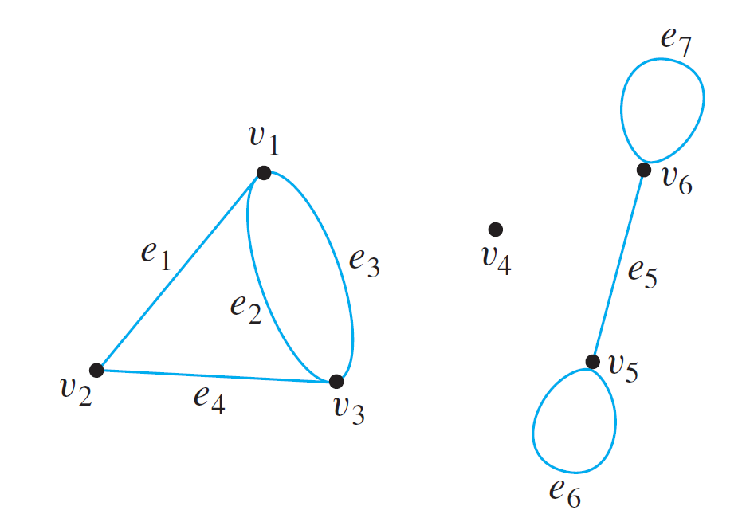
Graphs: Definitions and Basic Properties
Example: Consider the following graph:
Write the vertex set V and the edge set E, and give the list of edges with their end-points.
V = {v₁, v₂, v₃, v₄, v₅, v₆}
E = {e₁, e₂, e₃, e₄, e₅, e₆, e₇}
e₁ = {v₁, v₂}
e₂ = {v₁, v₃}
e₃ = {v₁, v₃}
e₄ = {v₂, v₃}
e₅ = {v₅, v₆}
e₆ = {v₅}
e₇ = {v₆}

Slide 8
Graphs: Definitions and Basic Properties
Example: Consider the following graph:
Find all edges that are incident on v₁, all vertices that are adjacent to v₁, all edges that are adjacent to e₁, all loops, all parallel edges, and all vertices that are adjacent to themselves.
Edges incident on v₁: e₁, e₂ and e₃.
Vertices adjacent to v₁: v₂ and v₃.
Edges adjacent to e₁: e₂, e₃ and e₄.
Loops: e₆ and e₇.
e₂ and e₃ are parallel.
v₅ and v₆ are adjacent to themselves.

Slide 9
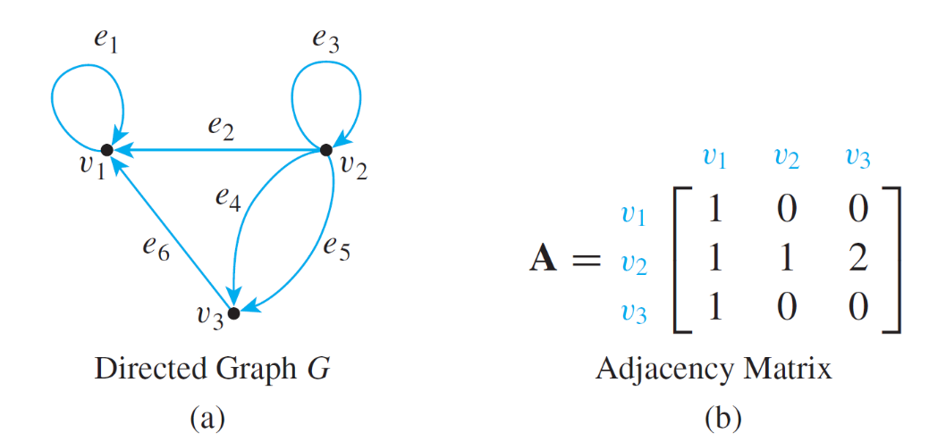
Graphs: Definitions and Basic Properties
Definition: Directed Graph
A directed graph, or digraph, G, consists of 2 finite sets: a nonempty set V(G) of vertices and a set D(G) of directed edges, where each edge is associated with an ordered pair of vertices called its endpoints.
If edge e is associated with the pair (v, w) of vertices, then e is said to be the (directed) edge from v to w. We write e = (v, w).
Undirected graph
Directed graph

Slide 10
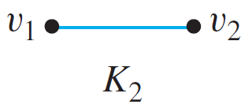
Simple Graphs and Complete Graphs
Definition: Simple Graph
A simple graph is an undirected graph that does not have any loops or parallel edges.
Definition: Complete Graph
A complete graph on n vertices, n > 0, denoted K_{n}, is a simple graph with n vertices and exactly one edge connecting each pair of distinct vertices .
Example: The complete graphs K₁, K₂, K₃ and K₄.
Draw
K₅.

Slide 11
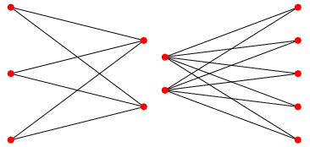
S
Complete Bipartite Graphs
Definition: Complete Bipartite Graph
A complete bipartite graph on (m, n) vertices, where m, n > 0, denoted K_{m,n}, is a simple graph with distinct vertices v₁, v₂,…, v_{m}, and w₁, w₂,…, w_{n} that satisfies the following properties:
For all i, k = 1, 2, …, m and for all j, l = 1, 2, …, n,
There is an edge from each vertex v_{i} to each vertex w_{j}.
There is no edge from any vertex v_{i} to any other vertex v_{k}.
There is no edge from any vertex w_{j} to any other vertex w_{l}.
K_{3,2}
K_{2,5}

Slide 12
S
General Bipartite Graphs
Definition: Bipartite
A simple graph G is bipartite if there are two subsets U and W of
the vertex set V of G such that
1. U∪ W = V and U∩ W = φ, and
2. every edge of G connects a vertex in U with a vertex in W.
So there are no edges connecting between vertices of U or vertices of W.
Example: Which of these is bipartite?
v₂
v₄
v₃
Ans: Only the left-hand side graph: U={v₁ , v₄}, V={v₂ , v₃}
v₂
v₁
v₃
v₁

Slide 13
Subgraph of a Graph
Definition: Subgraph of a Graph
A graph H is said to be a subgraph of graph G if, and only if, every vertex in H is also a vertex in G, every edge in H is also an edge in G, and every edge in H has the same endpoints as it has in G.
A graph G
A subgraph of G

Slide 14
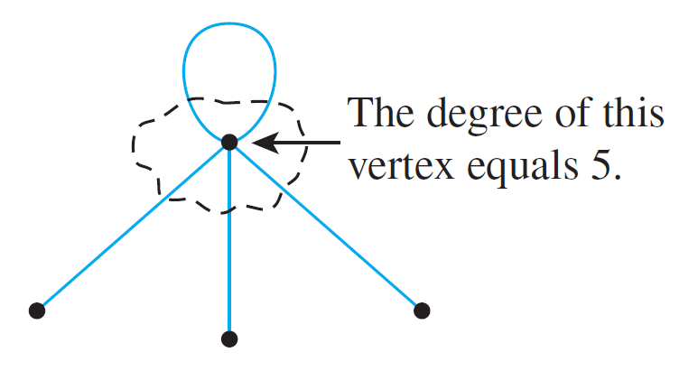
Degree of a Vertex and Total Degree of a Graph
Definition: Degree of a Vertex and Total Degree of a Graph
Let G be a graph and v a vertex of G. The degree of v, denoted deg(v), equals the number of edges that are incident on v, with an edge that is a loop counted twice.
The total degree of G is the sum of the degrees of all the vertices of G.
The degree of a vertex can be obtained from the drawing of a graph by counting how many end segments of edges are incident on the vertex.

Slide 15
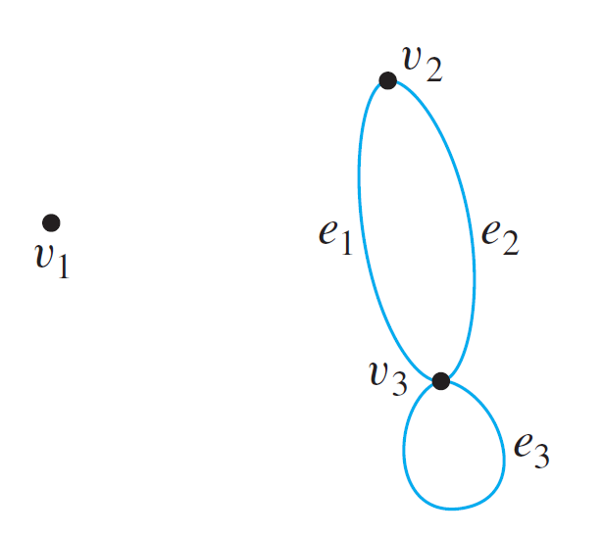
Degree of a Vertex and Total Degree of a Graph
Example: Find the degree of each vertex of the graph G shown below. Then find the total degree of G.
deg(v₁) = 0
deg(v₂) = 2
deg(v₃) = 4
Total degree of G = 6

Slide 16
The Concept of Degree
Theorem 10.1 The Handshake Theorem
If G is any graph, then the sum of the degrees of all the vertices of G equals twice the number of edges of G. Specifically, if the vertices of G are v₁, v₂, …, v_{n}, where n ≥ 0, then
The total degree of G = deg(v₁) + deg(v₂) + … + deg(v_{n})
= 2 × (the number of edges of G).
Corollary 10.1
The total degree of a graph is even.

Slide 17
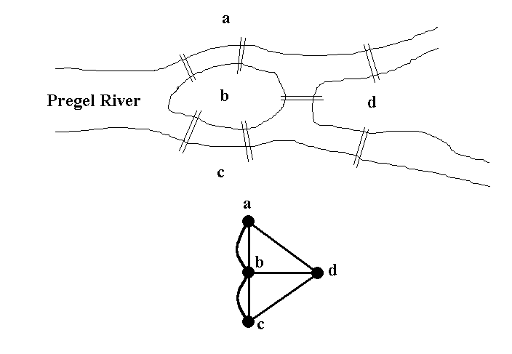
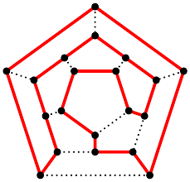
2: Trails, Paths, and Circuits

Slide 18
S
Let’s Have Some Fun
Can you draw the following figures without lifting up your pencil?
(1)
(2)
(3)
(4)
(5)
(6)
(7)
(8)

Slide 19
Königsberg bridges
The subject of graph theory began in the year 1736 when the great mathematician Leonhard Euler published a paper giving the solution to the following puzzle:
The town of Königsberg in Prussia (now Kaliningrad in Russia) was built at a point where two branches of the Pregel River came together. It consisted of an island and some land along the river banks.
These were connected by 7 bridges.

Slide 20
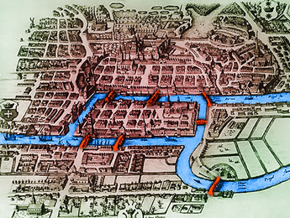
Königsberg bridges
Question: Is it possible to take a walk around town, starting and ending at the same location and crossing each of the 7 bridges exactly once?

Slide 21
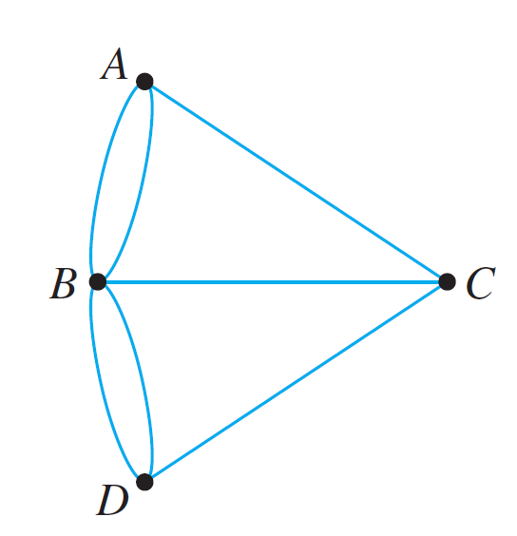
Königsberg bridges
In terms of this graph, the question is:
Is it possible to find a route through the graph that starts and ends at some vertex, one of A, B, C, or D, and traverses each edge exactly once and every vertex at least once?

Slide 22
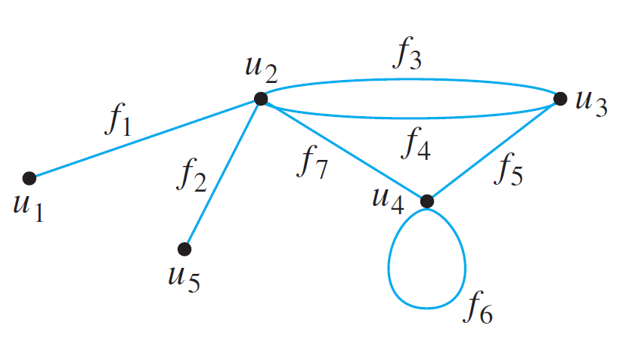
Definitions
Travel in a graph is accomplished by moving from one vertex to another along a sequence of adjacent edges.
In the graph below, for instance, you can go from u₁ to u₄ by taking f₁ to u₂ and then f₇ to u₄. This is represented by writing u₁ f₁ u₂ f₇ u₄.
Or, you could take a roundabout route:

Slide 23
Walk, Circuit, Simple Circuit
Definitions
Let G be a graph, and let v and w be vertices of G.
A walk from v to w is a finite alternating sequence of adjacent vertices and edges of G. Thus a walk has the form
v₀ e₁ v₁ e₂ … v_{n-1} e_{n} v_{n} ,
where the v’s represent vertices, the e’s represent edges, v₀=v, v_{n}=w, and for all i ∈ {1, 2, …, n}, v_{i-1} and v_{i} are the endpoints of e_{i}.

Slide 24
Walk, Trail, Path, Circuit, Simple Circuit
Definitions
A circuit (or cycle) is a walk that starts and ends at the same vertex, contains at least one edge and does not contain a repeated edge.
A simple circuit (or simple cycle) is a circuit that does not have any other repeated vertex except the first and last.

Slide 25
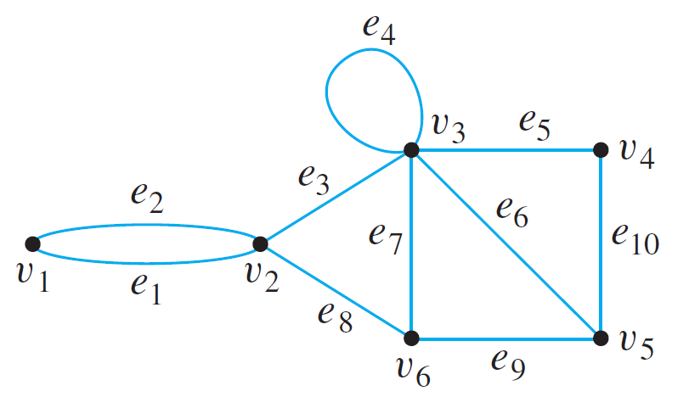



Walk, Trail, Path, Closed Walk, Circuit, Simple Circuit
In this graph, determine which of the following are walks, paths, circuits, or simple circuits.
a.
Walk; not a circuit; not a simple circuit.
b.
Circuit; not a simple circuit.
c.
Simple circuit.

Slide 26
Connectedness
A graph is connected if it is possible to travel from any vertex to any other vertex along a sequence of adjacent edges of the graph.
Definition: Connectedness
Two vertices v and w of a graph G are connected if, and only if, there is a walk from v to w.
The graph G is connected if, and only if, given any two vertices v and w in G, there is a walk from v to w. Symbolically,
G is connected iff ∀ vertices v, w ∈V(G), ∃ a walk from v to w.
The graph G is disconnected if it is not connected. So, G is disconnected if there are two vertices v and w in G with no walk between v and w.

Slide 27
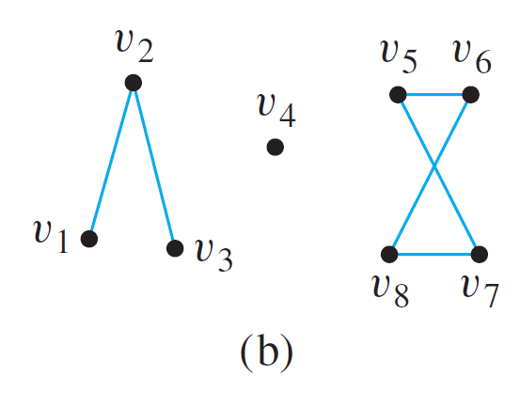
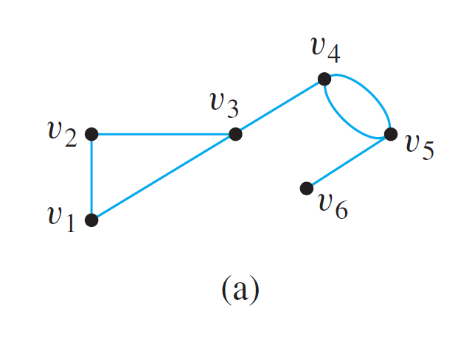
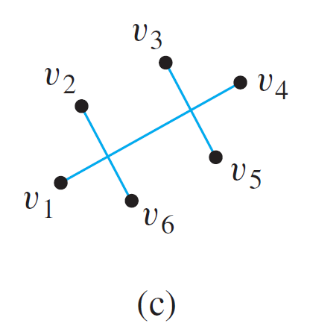
Connectedness
Example: Which of the following graphs are connected?
Yes
No
No

Slide 28
S
Connected Component
A connected component of a graph is a connected subgraph of largest possible size.
The graphs in (b) and (c) are both made up of three pieces, each of which is itself a connected graph.

Slide 29
S
Connectedness
Definition: Connected Component
A graph H is a connected component of a graph G if, and only if,
The graph H is a subgraph of G;
The graph H is connected; and
No connected subgraph of G has H as a subgraph and contains vertices or edges that are not in H.
The fact is that any graph is a kind of union of its connected components.

Slide 30
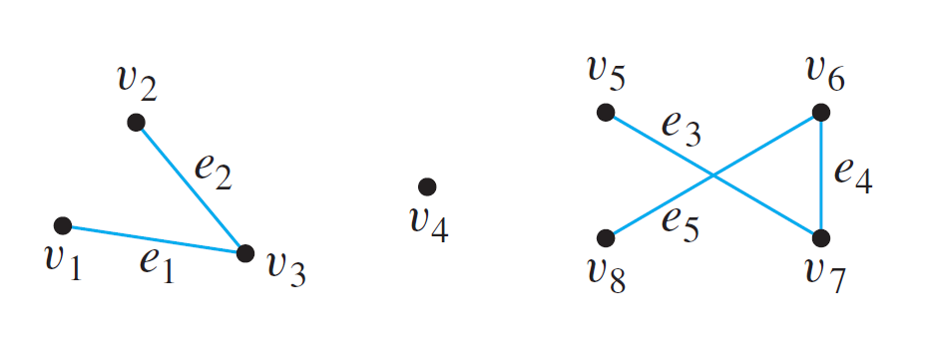
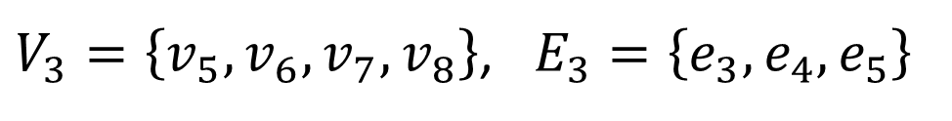
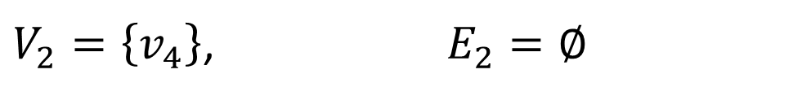
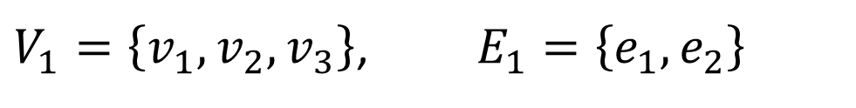
S
Connected Component
Find all connected components of the following graph G.
G has 3 connected components H₁, H₂ and H₃ with vertex sets V₁, V₂ and V₃ and edge sets E₁, E₂ and E₃ , where
$V_{1}=\left\{v_{1},v_{2},v_{3}\right\}$, $E_{1}=\left\{e_{1},e_{2}\right\}$
$V_{2}=\left\{v_{4}\right\}$, $E_{2}=∅$
$V_{3}=\left\{v_{5},v_{6},v_{7},v_{8}\right\}$, $E_{3}=\left\{e_{3},e_{4},e_{5}\right\}$

Slide 31
Euler Circuits
Now, let’s go back to the puzzle of the Königsberg bridges.
Is it possible to find a route through the graph that starts and ends at some vertex, one of A, B, C, or D, and traverses each edge exactly once and each vertex at least once?

Slide 32
Euler Circuits
Definition: Euler Circuit
Let G be a graph. An Euler circuit for G is a circuit that contains every vertex and every edge of G.
That is, an Euler circuit for G is a sequence of adjacent vertices and edges in G that has at least one edge, starts and ends at the same vertex, uses every vertex of G at least once, and uses every edge of G exactly once.
Definition: Eulerian Graph
An Eulerian graph is a graph that contains an Euler circuit.

Slide 33
Euler Circuits
Theorem 10.2
If a graph has an Euler circuit, then every vertex of the graph has positive even degree.
Contrapositive Version of Theorem 10.2
If some vertex of a graph has odd degree, then the graph does not have an Euler circuit.

Slide 34


S
Euler Circuits
Does each of the following graphs have an Euler circuit?
(1)
(2)
(3)
(4)
(5)
(6)
(7)
(8)

Slide 35
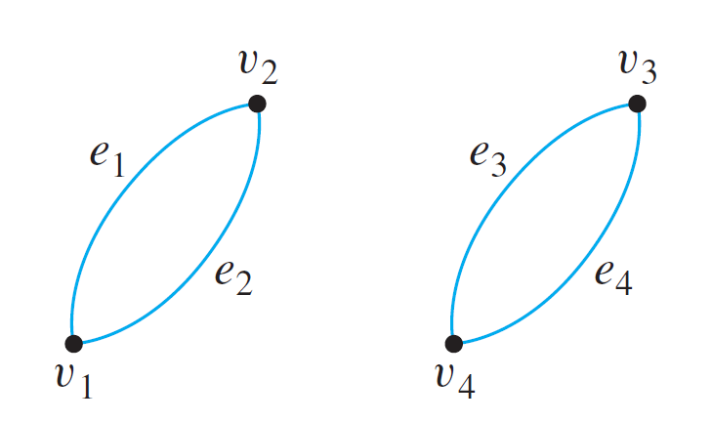
Euler Circuits
Is the converse of Theorem 10.2 true?
If every vertex of a graph has even degree, then the graph has an Euler circuit.
Not true!

Slide 36
Euler Circuits
Theorem 10.3
A graph G has an Euler circuit if, and only if, G is connected and every vertex of G has positive even degree.
The proof of this theorem is not within our scope.
Corollary 10.2 (given in next slide) from Theorem 10.3 will give a criterion for determining when it is possible to find a walk from one vertex of a graph to another, passing through every vertex of the graph at least once and every edge of the graph exactly once.

Slide 37
Euler Path
Definition: Euler Path
Let G be a graph, and let v and w be two distinct vertices of G. An Euler path from v to w is a sequence of adjacent edges and vertices that starts at v, ends at w, passes through every vertex of G at least once, and traverses every edge of G exactly once.
Corollary 10.2
Let G be a graph, and let v and w be two distinct vertices of G. There is an Euler path from v to w if, and only if, G is connected, v and w have odd degree, and all other vertices of G have positive even degree.
The proof of this corollary is not within our scope.

Slide 38
Back to Königsberg bridges
Is it possible to find a route through the graph that starts and ends at some vertex, one of A, B, C, or D, and traverses each edge exactly once and every vertex at least once?
Now, we should be able to answer.
Ans: No as there is no Euler circuit exist in this graph.

Slide 39
S
3: Isomorphisms of Graphs

Slide 40
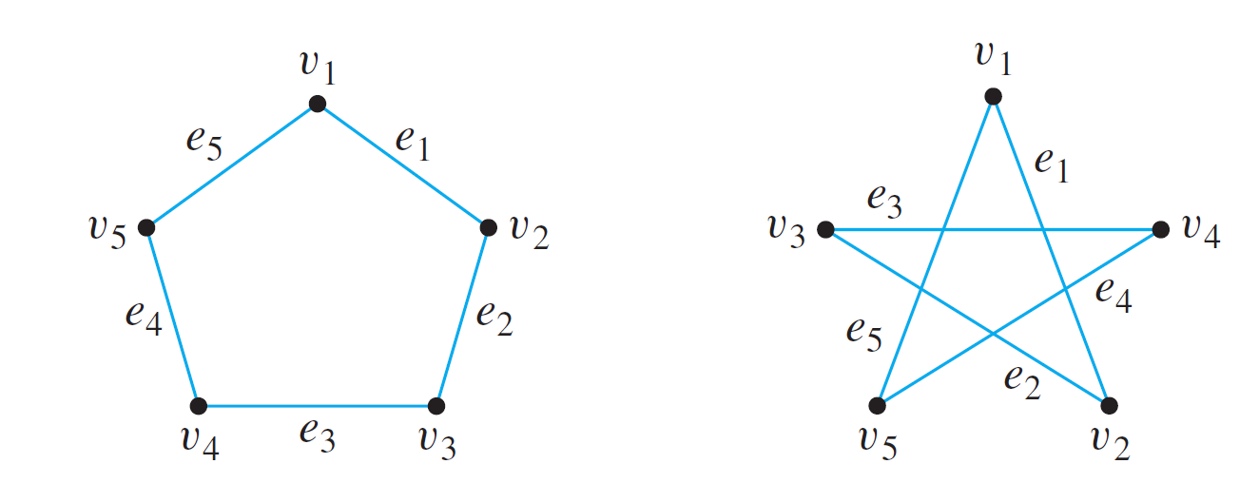
S
Isomorphisms of Graphs
The two drawings shown in Figure 10.1 both represent the same graph: Their vertex and edge sets are identical, and their edge-endpoint functions are the same. Call this graph G.
Figure 10.1

Slide 41
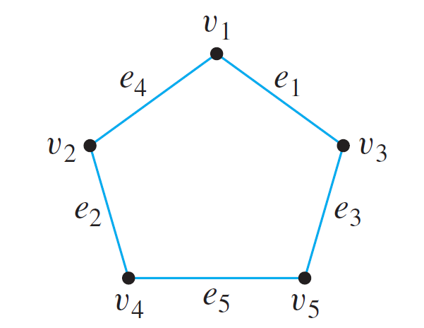
S
Isomorphisms of Graphs
Now consider the graph G' represented in Figure 10.2.
Figure 10.1
Figure 10.2
Observe that G' is a different graph from G (for instance, in G the endpoints of e₁ are v₁ and v₂, whereas in G' the endpoints of e₁ are v₁ and v₃).

Slide 42
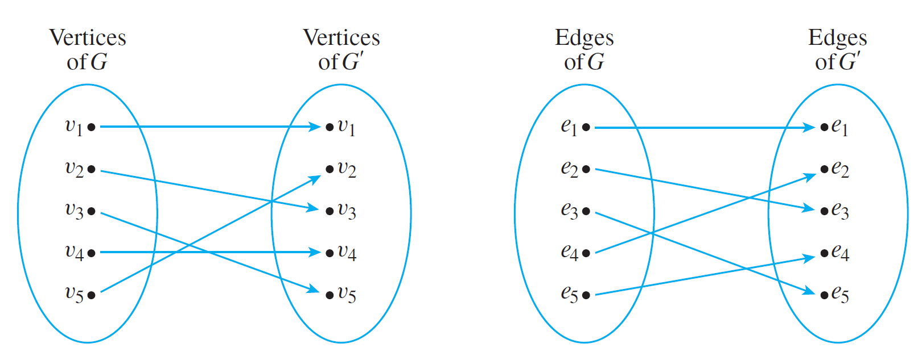
S
Isomorphisms of Graphs
Yet G' is certainly very similar to G. In fact, if the vertices and edges of G' are relabeled by the functions shown in Figure 10.3, then G' becomes the same as G.
Figure 10.3
Note that these relabeling functions are one-to-one and onto.

Slide 43
S
Isomorphisms of Graphs
Two graphs that are the same except for the labeling of their vertices and edges are called isomorphic.
Definition: Isomorphic Graph
Let G and G' be graphs with vertex sets V(G) and V(G') and edge sets E(G) and E(G') respectively.
G is isomorphic to G‘ if, and only if, there exist one-to-one correspondences g: V(G) → V(G') and h: E(G) → E(G') that preserve the edge-endpoint functions of G and G' in the sense that for all v ∈ V(G) and e ∈ E(G),
v is an endpoint of e ⇔ g(v) is an endpoint of h(e).

Slide 44
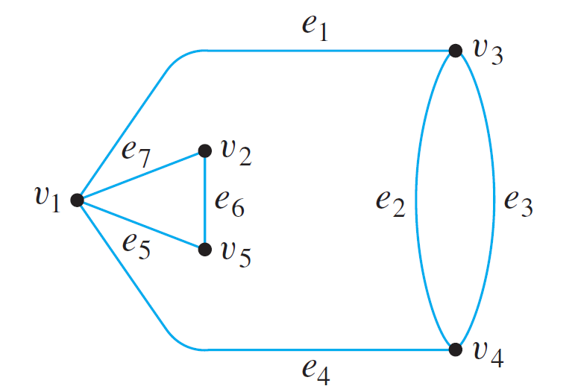
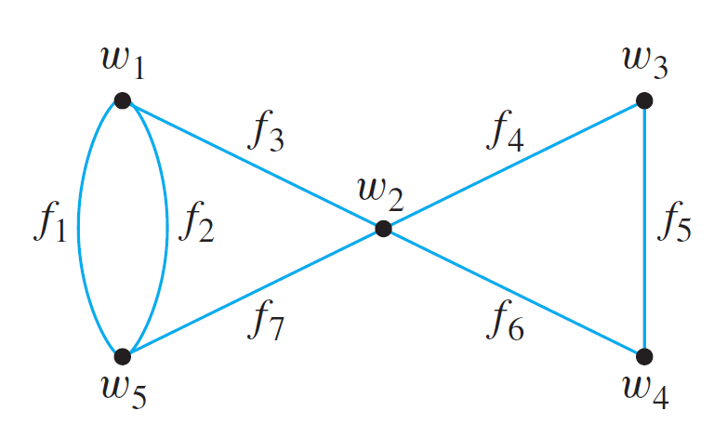
S
Isomorphisms of Graphs
Example: Show that the following two graphs are isomorphic.
To solve this, you find functions g: V(G) → V(G') and h: E(G) → E(G') such that for all for all v ∈ V(G) and e ∈ E(G), v is an endpoint of e if, and only if, g(v) is an endpoint of h(e).

Slide 45
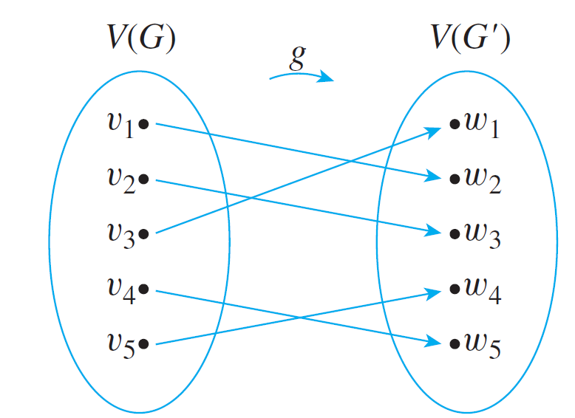
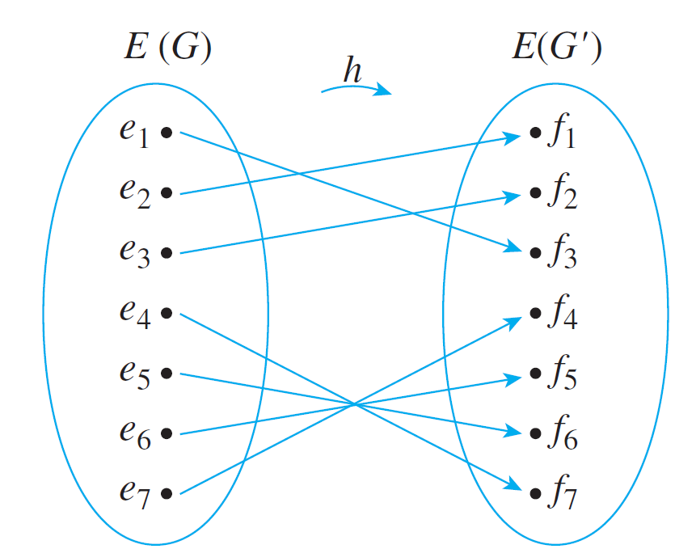
S
Isomorphisms of Graphs
Graphs: Definitions Trails, Paths, and Circuits Matrix Representations Planar Graphs
Example: Show that the following two graphs are isomorphic.
For example, v₄ is an endpoint of e₃, g(v₄) = w₅ is an endpoint of h(e₃ )= f₂. And, w₂ = g(v₁) is an endpoint of f₇ = h(e₄ ) , v₁ is an endpoint of e₄

Slide 46
4: Tree and Minimum Spanning Tree

Slide 47
Definition
Definition: Tree
A graph is said to be circuit-free if, and only if, it has no circuits.
A graph is called a tree if, and only if, it is circuit-free and connected.
A trivial tree is a graph that consists of a single vertex.
Note: A circuit (or cycle) is a walk that starts and ends at the same vertex and contains at least one edge and does not contain a repeated edge.

Slide 48
Trees: Examples
Which of the following are trees?
G₁:
G₂:
G₃:
Ans: yes
Ansno
Ans:no
G₄:
G₅:
G₆:
Ans: yes
Ans:yes
Ans:no

Slide 49
Characterizing Trees
Theorem 10.4
Any tree with n vertices (n > 0) has n – 1 edges.
Theorem 10.5
If G is a connected graph with n vertices and n – 1 edges, then G is a tree.
The proof of these theorems are not within our scope
Example: Draw a graph with 5 vertices and 4 edges, but which is not a tree.
v₁
v₃
v₂
v₂
v₄

Slide 50
Definitions
Definition: Spanning Tree
A spanning tree for a graph G is a subgraph of G that contains every vertex of G and is a tree.
Theorem 10.6
Every connected graph has a spanning tree.
Any two spanning trees for a graph have the same number of edges.
The proof of this theorem is not within our scope

Slide 51
Definitions
Example: Find all spanning trees for the graph G below.
The graph G has one circuit v₂v₁v₄v₂ and removal of any edge of the circuit gives a tree. Hence there are three spanning trees for G.

Slide 52
Minimum Spanning Trees
Definitions: Weighted Graph, Minimum Spanning Tree
A weighted graph is a graph for which each edge has an associated positive real number weight . The sum of the weights of all the edges is the total weight of the graph.
A minimum spanning tree for a connected weighted graph is a spanning tree that has the least possible total weight compared to all other spanning trees for the graph.
If G is a weighted graph and e is an edge of G, then w(e) denotes the weight of e and w(G) denotes the total weight of G.

Slide 53
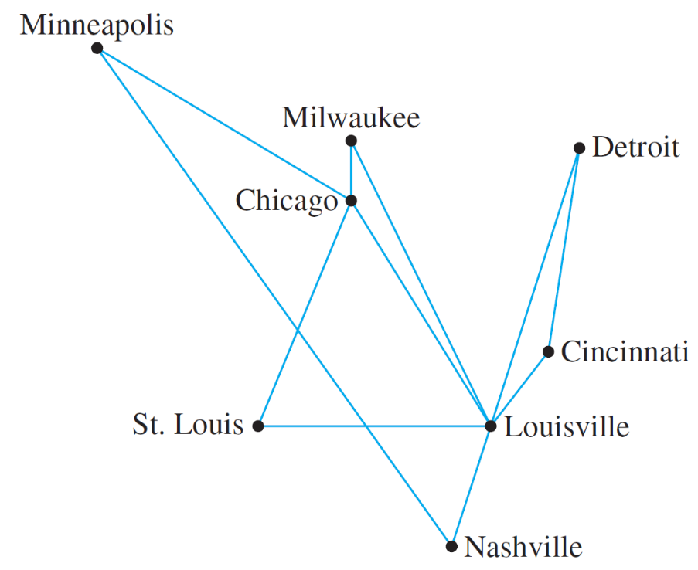
Example and Application of Minimum Spanning Tree
An East Coast airline company wants to expand service to the Midwest and has received permission from the Federal Aviation Authority to fly any of the routes shown in Figure 10.4.
Figure 10.4

Slide 54
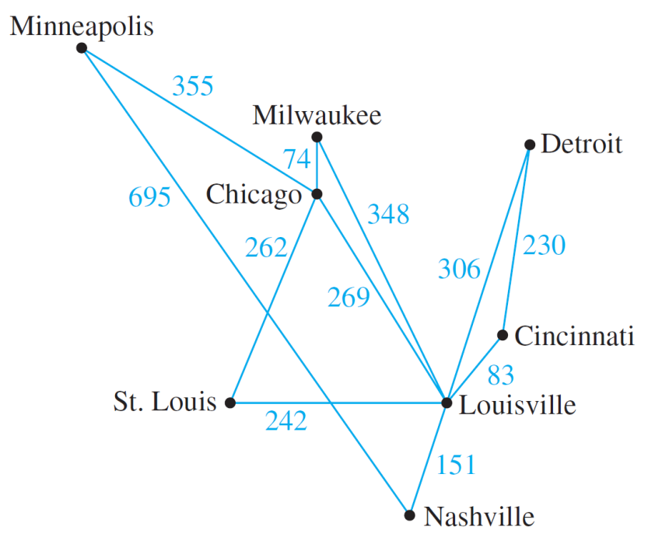
Example and Application of Minimum Spanning Tree
The graph of the routes allowed by the Federal Aviation Authority shown in Figure 10.4 can be annotated by adding the distances (in miles) between each pair of cities.
Now suppose the airline company wants to serve all the cities shown, but with a route system that minimizes the total mileage.
This problem can be solved by finding minimum spanning trees in the graph shown in Figure 10.5.
Finding minimum spanning tree is certainly an important problem. It is in general a hard problem. We need good algorithm to find minimum spanning trees.
Figure 10.5

Slide 55
Kruskal’s Algorithm (Joseph B. Kruskal, 1956)
In Kruskal’s algorithm, the edges of a connected weighted graph are examined one by one in order of increasing weight.
At each stage the edge being examined is added to what will become the minimum spanning tree, provided that this addition does not create a circuit.
After n – 1 edges have been added (where n is the number of vertices of the graph), these edges, together with the vertices of the graph, form a minimum spanning tree for the graph.

Slide 56
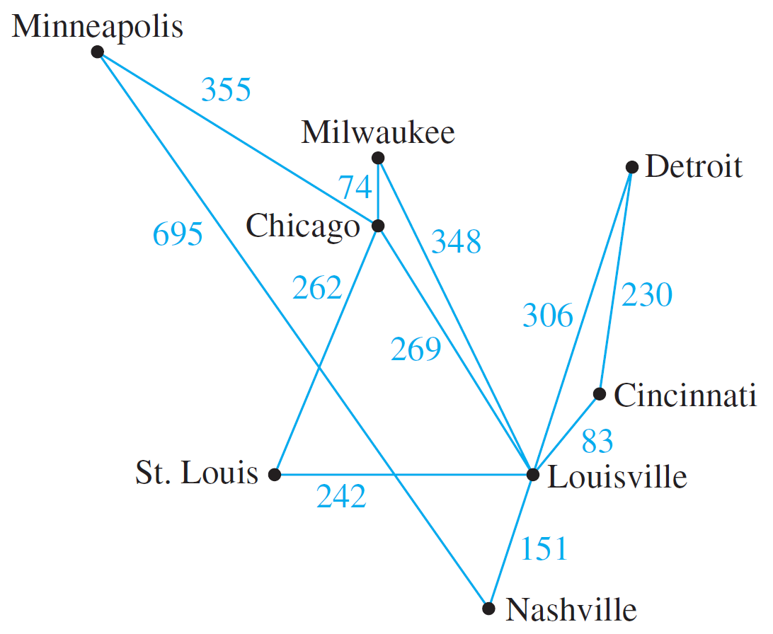
Kruskal’s Algorithm
Example: Describe the action of Kruskal’s algorithm on the graph shown in Figure 10.5, where n = 8.
Figure 10.5

Slide 57

Kruskal’s Algorithm
Using Kruskal’s algorithm we can formulate the following table.
 | Edge considered | Wt | Action taken
1 | Chi – Mil | 74
2 | Lou – Cin | 83
3 | Lou – Nas | 151
4 | Cin – Det | 230
5 | StL – Lou | 242
6 | StL – Chi | 262
7 | Chi – Lou | 269
8 | Lou – Det | 306
9 | Lou – Mil | 348
10 | Min – Chi | 355
added
added
added
added
added
added
not added
not added
Figure 10.6
not added
added
When Kruskal’s algorithm is used on a graph in which some edges have the same weight as others, more than one minimum spanning tree can occur as output.

Slide 58
Prim’s Algorithm (Robert C. Prim, 1957)
Prim’s algorithm works differently from Kruskal’s.
In this algorithm we builds a minimum spanning tree T for a connected graph of n vertices by starting from any vertex, and at each stage, we add one new edge of least weight that connects one vertex in T and another vertex not in T until T has (n-1) edges.

Slide 59
Prim’s Algorithm
Example: Describe the action of Prim’s algorithm on the graph shown in Figure 10.5, using the Minneapolis vertex as a starting point.
Figure 10.5

Slide 60
Prim’s Algorithm
Using Prim’s algorithm we can formulate the following table.
 | Vertex added | Edge added | Weight
0 | Minneapolis
1
2
3
4
5
6
7
Chicago
Min – Chi
355
Milwaukee
Chi – Mil
74
St. Louis
Chi – StL
262
Louisville
StL – Lou
242
Cincinnati
Lou – Cin
83
Nashville
Lou – Nas
151
Detroit
Cin – Det
230
Figure 10.7
Same as Kruskal’s algorithm, when prim’s algorithm is used on a graph in which some edges have the same weight as others, more than one minimum spanning tree can occur as output.

Slide 61
Correctness of Kruskal’s and Prim’s Algorithms
It can be proved that both algorithms are always correct --- always output a minimum spanning tree.
The proof of their correctness is not within our scope.

Slide 62
End of Unit 10

